Slide 1
Pandas & Matplotlib
Khashayar mohammadi, Amirhossein ghozati, Ali soleymani

Slide 2

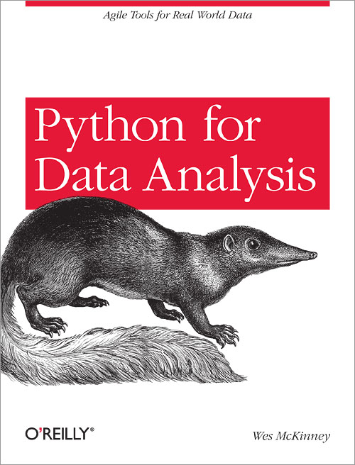
Pandas
Created in 2008 by Wes McKinney
Acronym for Panel data and Python data analysis
Its aim is to carry out your entire data analysis workflow in Python without having to switch to a more domain specific language like R.

Slide 3
Pandas
Import first with import pandas as pd or from pandas import DataFrame, Series
Two “workhorse” data-structures
Series
DataFrames

Slide 4
Pandas | Series
A Series is one-dimensional array-like object containing an array of data (of any NumPy datatype) and an associated array of data-labels, called its index
In [0]: obj = pd.Series([4, 7, -5, 3])
In [1]: obj
Out[1]:
0 4
1 7
2 -5
3 3

Slide 5
Pandas | Series
The index does not have to be numerical. You can specify other datatypes, for instance strings
In [0]: obj2 = pd.Series([4, 7, -5, 3], index=['d','b','a','c'])
In [1]: obj2
Out[1]:
d 4
b 7
a -5
c 3

Slide 6
Pandas | Series
Get the list of indices with the .index property
In [5]: obj.index
Out[5]: Int64Index([0, 1, 2, 3])
And the values with .values
In [6]: obj.values
Out[6]: array([ 4, 7, -5, 3])

Slide 7
Pandas | Series
You can get or change values by their index
obj[2] # -5 obj2['b'] # 7 obj2['d'] = 6
Or ranges of values
obj[[0, 1, 3]] # Series[4, 7, 3] obj2[['a','c','d']] # Series[-5, 3 ,6]
Or criteria
obj2[obj2 > 0]
d 6 b 7 c 3

Slide 8
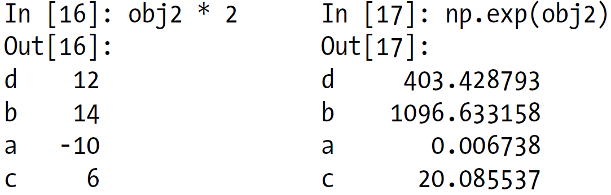
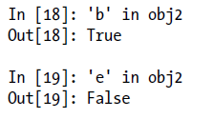
Pandas | Series
You can perform calculations on the whole Series
And check if certain indices are present with in

Slide 9
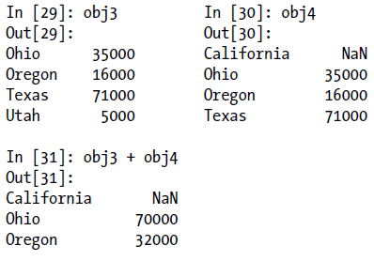

Pandas | Series
Similar Series objects can be combined with arithmetic operations. Their data is automatically aligned by index

Slide 10
Pandas | DataFrames
DataFrame
Tabular, spreadsheet-like data structure containing an ordered collection of columns of potentially different value types (numeric, string, etc.)
Has both a row and column index
Can be regarded as a ‘dict of Series’

Slide 11
Pandas | DataFrames
data = {'state': ['Ohio', 'Ohio', 'Ohio', 'Nevada','Nevada'],
'year': [2000, 2001, 2002, 2001, 2002],
'pop': [1.5, 1.7, 3.6, 2.4, 2.9]}
frame = pd.DataFrame(data)
In [38]: frame
Out[38]:
pop state year
0 1.5 Ohio 2000
1 1.7 Ohio 2001
2 3.6 Ohio 2002
3 2.4 Nevada 2001
4 2.9 Nevada 2002
Or specify your own index and order of columns

Slide 12
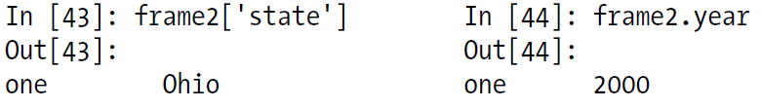
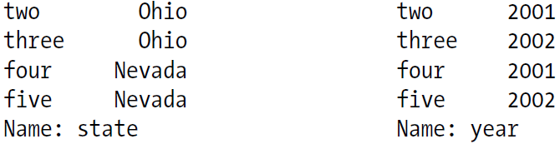
Pandas | DataFrames
A column in a DataFrame can be retrieved as a Series by dict-like notation or by attribute

Slide 13
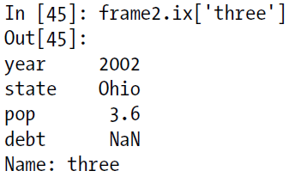
Pandas | DataFrames
A Row can be retrieved by the .ix() method
Individual values with column/index notation frame["state"][3] # Nevada frame2["year"]["three"] # 2002 frame.state[0] # Ohio frame2.state.two # Ohio (only labeled indices)

Slide 14

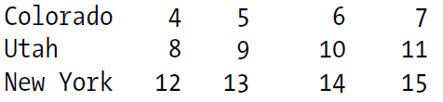
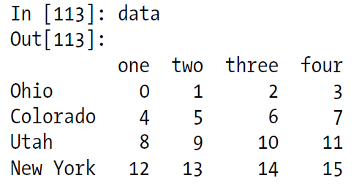
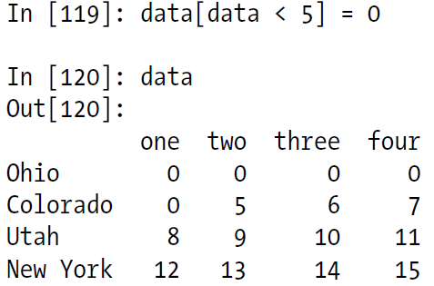
Pandas | DataFrames
You can also select and/or manipulate slices

Slide 15
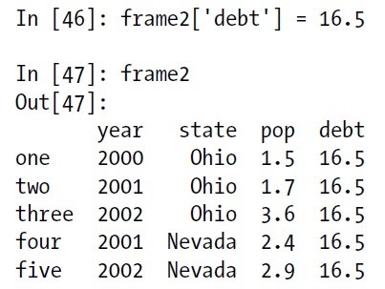
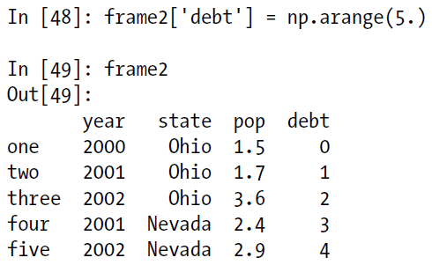
Pandas | DataFrames
You can assign a scalar (single) value or an array of values to a column
If the column does not exist yet, it will be created. Otherwise its contents are overwritten.

Slide 16
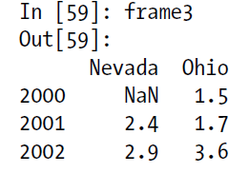
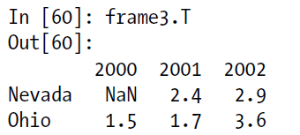
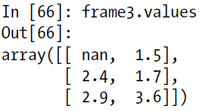
Pandas | DataFrames
The dataframe's .T attribute will transpose it
The .values attribute will return the data as a 2D ndarray

Slide 17
Pandas | Reading data
Creating DataFrames manually is all very nice …..
… but probably you're never going to use it!
Pandas offers a wide range of functions to create DataFrames from external data sources
pd.read_csv(…)
pd.read_excel(…)
pd.read_html(…)
pd.read_table(…)
pd.read_clipboard()!
Nothing for SPSS (.sav) at the moment…

Slide 18


Example data set
Experiment: Meeters & Olivers, 2006
Intertrial priming
3 vs. 12 elements (blocked)
Target feature change vs repetition
Search for symbol or missing corner (blocked)

Slide 19
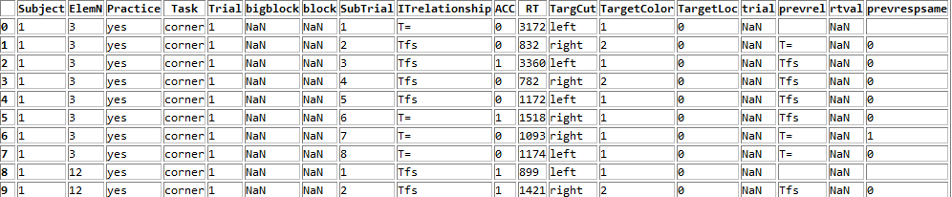
Pandas | Example dataset
Start with reading in dataset
Excel file so we'll use pd.read_excel(<file>,<sheet>)
import pandas as pd raw_data = pd.read_excel(”Dataset.xls","raw")

Slide 20
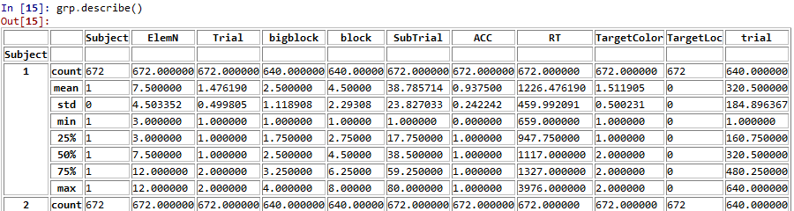
Pandas | Describe()
DataFrames have a describe() function to provide some simple descriptive statistics
# First group data per participant grp = raw_data.groupby("Subject") # Then provide some descriptive stats per participant grp.describe()

Slide 21
Pandas | Filtering
Filter data with following criteria:
Disregard practice block
Practice == no
Only keep correct response trials
ACC == 1
No first trials of blocks (contain no inter-trial info)
Subtrial > 1
Only RTs that fall below 1500 ms
RT < 1500

Slide 22
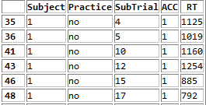
Pandas | Filtering: method 1
Separate evaluations with & and it's safer to use ()
work_data = raw_data[
(raw_data["Practice"] == "no") &
(raw_data["ACC"] == 1) &
(raw_data["SubTrial"] > 1) &
(raw_data["RT"] < 1500)
] work_data[["Subject","Practice","SubTrial","ACC","RT"]]

Slide 23
Pandas | Filtering: method 2
Use DataFrames convenient query() method
Accepts a string stating the criteria
crit = "Practice == 'no' and ACC == 1 and SubTrial > 1 and RT < 1500"
work_data = raw_data.query(crit)
Exactly the same result

Slide 24
Pandas | Pivot tables
A pivot table is very useful tool to collapse data over factors, subjects, etc.
You can specify an aggregation function that is to be performed for each resulting data cell
Mean
Count
Std
Any function that takes sequences of data

Slide 25
Pandas | Pivot tables
Basic syntax
df.pivot_table( values, # dependent variable(s) (RT) index, # subjects columns, # independent variable(s) aggfunc # Aggregation function
)

Slide 26
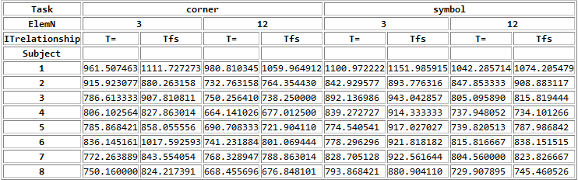
Pandas | Pivot tables
ind_vars=["Task","ElemN","ITrelationship"]
RT_pt = work_data.pivot_table(values="RT",
index="Subject",
columns=ind_vars,
aggfunc="mean"
)

Slide 27
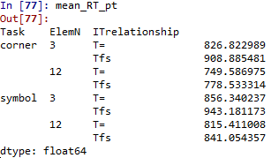
Pivot tables | Mean
Now to get the mean RT of all subjects per factor : mean_RT_pt = RT_pt.mean()
DataFrame.mean() automatically averages over rows. If you want to average over columns you need to pass the axis=1 argument

Slide 28
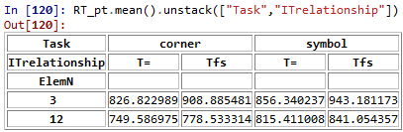
Pivot tables | Unstacking
Mean() returns a Series object, which is one-dimensional and less flexible than a DataFrame
With a Series' unstack() function you can pull desired factors into the "second dimension" again
You can pass the desired factors in a list
mean_RT_pt = mean_RT_pt.unstack(["Task","ITrelationship"])

Slide 29
Pivot tables | Plotting
Plotting a dataframe is as simple as calling its .plot() function, which has the basic syntax:
df.plot( kind, # line, bar, scatter, kde, density, etc. [x|y]lim, # Limits of x- or y-axis [x|y]err, # Error bars in x- or y-direction
title, # Title of figure
grid # Draw grid (True) or not (False) )

Slide 30
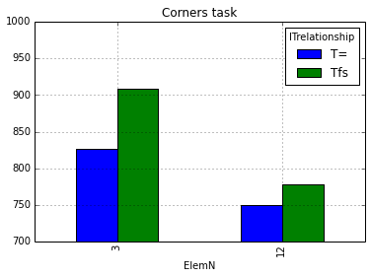
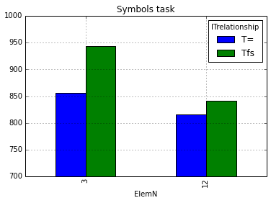
Pivot tables | Plotting
mean_RT_pt["corner"].plot(
kind="bar", ylim=[700,1000], title="Corners task")
mean_RT_pt["symbol"].plot( kind="bar", ylim=[700,1000], title="Symbols task")

Slide 31
Plotting | Error bars
We'll make our plots prettier later, but let's look at error bars first…
For simplicity, we'll just use the standard error values for the length of the error bars
Now to calculate these standard errors …
std_pt = RT_pt.std() std_pt = std_pt.unstack(["Task","ITrelationship"]) stderr_pt = std_pt/math.sqrt(len(RT_pt))
$$SE=\frac{σ}{\sqrt{n}}$$

Slide 32
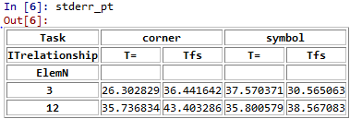
Chaining
You can directly call functions of the output object of another function. This allows you to make a chain of commands
std_pt = RT_pt.std().unstack(["Task","ITrelationship"]) stderr_pt = std_pt/math.sqrt(len(RT_pt))
Or even
stderr_pt = RT_pt.std().unstack(["Task","ITrelationship"])/math.sqrt(len(RT_pt))

Slide 33

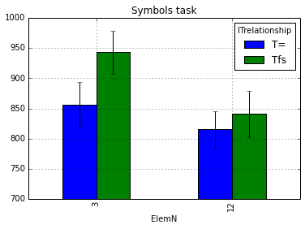
Plotting | Error bars
Pass the values of the df as the yerr argument
mean_RT_pt["corner"].plot( kind="bar", ylim=[700,1000], title="Corners task", yerr=stderr_pt["corner"].values)
mean_RT_pt["symbol"].plot( kind="bar", ylim=[700,1000], title="Symbols task", yerr=stderr_pt["symbol"].values)

Slide 34
Full example
# Read in data from Excel file. Second argument specifies sheet
raw_data = pd.read_excel(”Dataset.xls","raw")
# Filter data according to criteria specified in crit
crit = "Practice == 'no' and ACC == 1 and SubTrial > 1 and RT < 1500"
work_data = raw_data.query(crit)
# Make a pivot table of the RTs
ind_vars=["Task","ElemN","ITrelationship"]
RT_pt = work_data.pivot_table(values="RT",index="Subject",
columns=ind_vars, aggfunc="mean")
# Create mean RT and stderr for each column (factor level combination)
mean_RT_pt = RT_pt.mean().unstack(["Task","ITrelationship"])
std_pt = RT_pt.std().unstack(["Task","ITrelationship"])
stderr_pt = std_pt/math.sqrt(len(RT_pt))
# Plot the data with error bars
mean_RT_pt["corner"].plot(kind="bar", ylim=[700,1000],
title="Corners task", yerr=stderr_pt["corner"].values, grid=False)
mean_RT_pt["symbol"].plot(kind="bar", ylim=[700,1000],
title="Symbols task", yerr=stderr_pt["symbol"].values, grid=False)

Slide 35
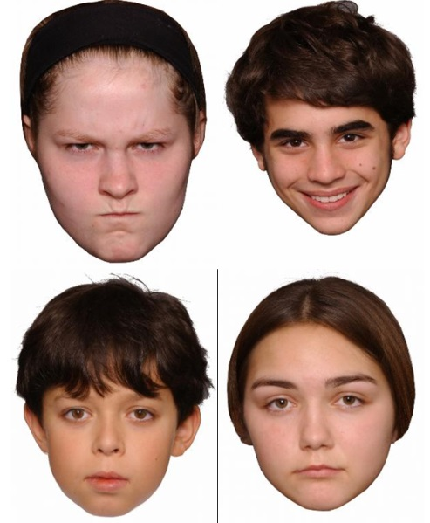
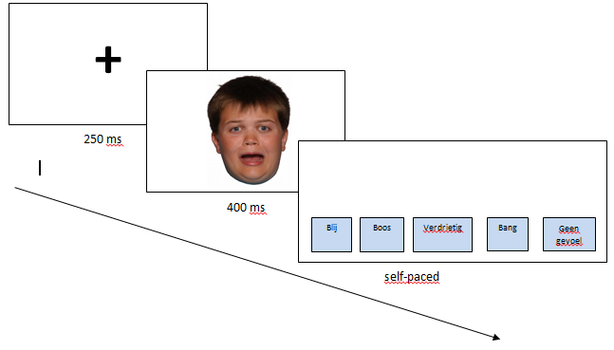
Example dataset 2
Recognition of facial emotions Pilot data of C. Bergwerff
Boys vs. girls
4 emotion types + neutral face
Task is to indicate emotion expressed by face

Slide 36
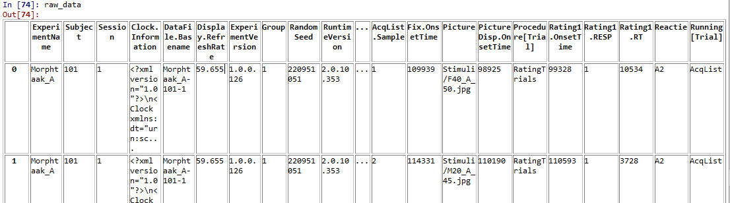
Example 2 | Read in data
Read in datafile. In this case it is an export of E-Prime data, which is delimited text, separated by tab characters (\t)
raw_data = pd.read_csv("merged.txt",sep="\t")

Slide 37
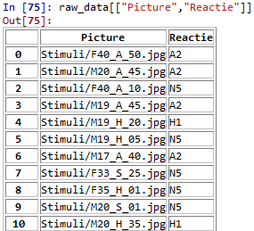
Example 2 | Responses
Correctness of response not yet determined!
Needs to be established by correspondence of 2 columns: Picture and Reactie
If letter in picture after underscore(!) corresponds with first letter of Reactie: ACC = 1, else ACC = 0

Slide 38
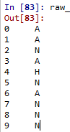
Example 2 | Vectorized String ops
You can perform (very fast) operations for each row containing a string in a column, so-called vectorized operations.
String operations are done by using the DataFrames .str function set
Example: we want only the first letter of all strings in Reactie
reponses = raw_data["Reactie"].str[0]
or
reponses = raw_data["Reactie"].str.get(0)

Slide 39
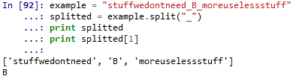
Example 2 | Vectorized String ops
The second one is a bit tougher. We need the letters between the underscores (_) in the strings in Stimuli
Easiest is to use the split() method, which splits a string into a list at the specified character

Slide 40
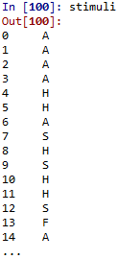
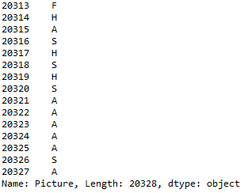
Example 2 | Vectorized String ops
Now to vectorize this operation….
stimuli = raw_data["Picture"].str.split("_").str[1]

Slide 41
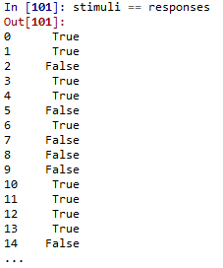
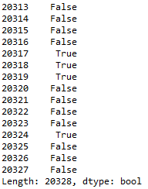
Example 2 | Accuracy scores
Now we have two Series we can directly compare! Let's see where they correspond:

Slide 42
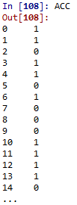
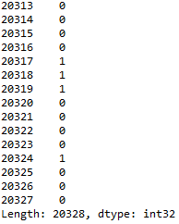
Example 2 | Accuracy scores
If you want those as int (True = 1, False = 0), you can do:
ACC = (stimuli == responses).astype(int)

Slide 43
Example 2 | Accuracy scores
Let's add these columns to our main DataFrame:
raw_data["ACC"]=(stimuli == responses).astype(int) raw_data["Response"] = responses
The stimuli Series, however could contain more informative labels then "A","F","H" and "S". Let's relabel these…

Slide 44
Example 2 | relabelling
For this, we'll use the vectorized replace operation
stimuli = stimuli.str.replace("A","Angry") stimuli = stimuli.str.replace("F","Fearful") stimuli = stimuli.str.replace("H","Happy") stimuli = stimuli.str.replace("S","Sad")
Or, when chained:
stimuli = stimuli.str.replace("A","Angry").str.replace("F","Fearful").str.replace("H","Happy").str.replace("S", "Sad")
Finally add this Series to the main DataFrame too
raw_data["FaceType"] = stimuli

Slide 45
Example 2 | Pivot table
Create a pivot table:
pt = raw_data.pivot_table( values="ACC", index="Subject", columns=["Gender","FaceType"], aggfunc="mean")
And let's plot!
pt.mean().unstack().T.plot( kind="bar", rot=0, ylim=[.25,.75], grid=False)

Slide 46
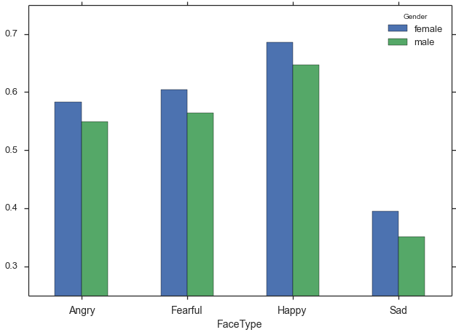
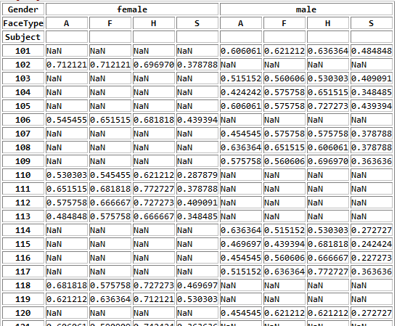
Example 2 | Plot

Slide 47
Full Example 2
import pandas as pd
import math
raw_data = pd.read_csv("merged.txt",sep="\t")
stimuli = raw_data["Picture"].str.split("_").str[1]
stimuli = stimuli.str.replace("A","Angry").str.replace("F","Fearful")
stimuli = stimuli.str.replace("H","Happy").str.replace("S", "Sad")
responses = raw_data["Reactie"].str[0]
raw_data["FaceType"] = stimuli
raw_data["Response"] = responses
raw_data["ACC"] = (stimuli.str[0] == responses).astype(int)
pt = raw_data.pivot_table(values="ACC", index="Subject",
columns=["Gender","FaceType"], aggfunc="mean")
(pt.mean().unstack().T).plot( kind="bar", rot=0, ylim=[.25,.75],
fontsize=14, grid=False )

Slide 48

Matplotlib
Most popular plotting library for Python
Created by (late) John Hunter
Has a lot in common with MatLab's plotting library, both functionally and syntactically
Syntax can be a bit archaic sometimes, therefore other libraries have implemented their own interface to Matplotlib's plotting functions (e.g. Pandas, Seaborn)

Slide 49
Matplotlib
Main module is pyplot, often imported as plt
import matplotlib.pyplot as plt
Now you can for example do
plt.plot(np.linspace(0,10),np.linspace(0,10))
If IPython is started with the pylab flag, all plotting functions are available directly, without having to add plt (just as in MatLab)

Slide 50
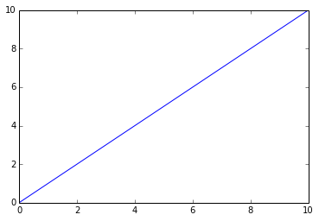
Matplotlib | Axes object
When a plot function has been called, it creates an axes object, through which you can make cosmetical changes to the plot
lin = np.linspace(0,10,10) plt.plot(lin,lin)

Slide 51
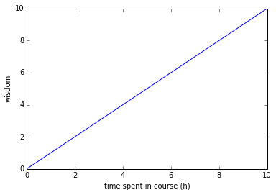
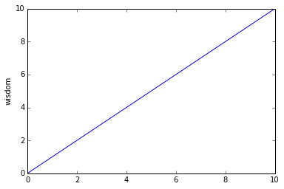
Matplotlib | Axes object
A reference to the current axes (latest plot) can be obtained by the gca() method (get current axis)
lin = np.linspace(0,10,10) plt.plot(lin,lin) ax = plt.gca() ax.set_ylabel("wisdom") ax.set_xlabel( "time spent in course (h)")

Slide 52
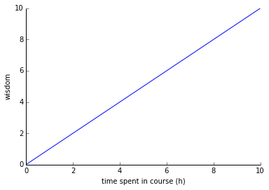
Matplotlib | Axes object
Removing the top and right axis (plus their ticks)
lin = np.linspace(0,10,10) plt.plot(lin,lin) ax = plt.gca() ax.set_ylabel("wisdom") ax.set_xlabel( "time spent in course (h)") ax.xaxis.tick_bottom() ax.yaxis.tick_left() ax.spines["right"].set_color("none") ax.spines["top"].set_color("none")

Slide 53
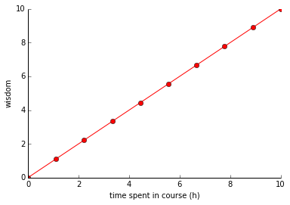
Matplotlib | Axes object
Show the data points on the line, and change its color to red (red, o's, unbroken - )
lin = np.linspace(0,10,10) plt.plot(lin,lin,"ro-") ax = plt.gca() ax.set_ylabel("wisdom") ax.set_xlabel( "time spent in course (h)") ax.xaxis.tick_bottom() ax.yaxis.tick_left() ax.spines["right"].set_color("none") ax.spines["top"].set_color("none")

Slide 54
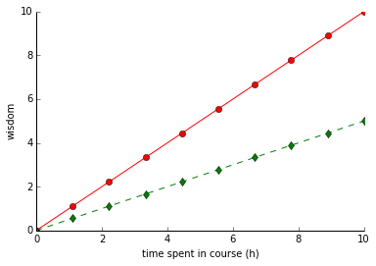
Matplotlib | Axes object
Add second series, with green diamons at the data points connected with a - - (dashed line)
No need to execute plt.hold() (or hold on; in MatLab)
lin = np.linspace(0,10,10) plt.plot(lin,lin,"ro-") ax = plt.gca() … lin2 = np.linspace(0,5,10) plt.plot(lin,lin2,"gd--")

Slide 55
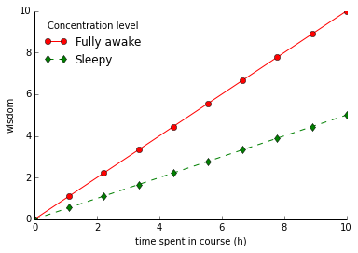
Matplotlib | Axes object
Add a legend for our series. Give the legend a title and remove its border
lin = np.linspace(0,10,10) plt.plot(lin,lin,"ro-") ax = plt.gca() … ax.legend( ["Fully awake","Sleepy"], loc="best") ax.get_legend().set_title( "Concentration level") ax.get_legend().draw_frame(False)

Slide 56
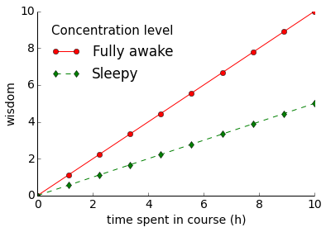
Matplotlib | Axes object
Finally, let's increase the font size a bit.
This is done in a bit strange way…
lin = np.linspace(0,10,10) plt.plot(lin,lin,"ro-") ax = plt.gca() … font = {'family' : 'normal', 'weight' : 'normal', 'size' : 14} plt.rc('font', **font)

Slide 57
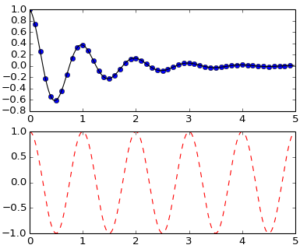
Matplotlib | Subplots
plt.subplot(rows, cols, plotnumber)
import numpy as np import matplotlib.pyplot as plt def f(t): return np.exp(-t) * np.cos(2*np.pi*t) t1 = np.arange(0.0, 5.0, 0.1) t2 = np.arange(0.0, 5.0, 0.02) plt.figure(1) plt.subplot(211) plt.plot(t1, f(t1), 'bo', t2, f(t2), 'k') plt.subplot(212) plt.plot(t2, np.cos(2*np.pi*t2), 'r--') plt.show()

Slide 58
Pandas | Plotting
When you call the DataFrame.plot() function, it returns a reference or handle to the Axes object
With this, after plotting with Pandas, we can still make changes to our plots
Let's return to the plots of our first example and polish things up…

Slide 59
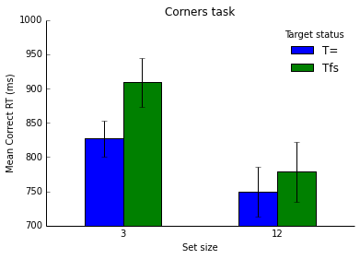
Matplotlib | Example 1
Make Figure more APA-like
ax = mean_RT_pt["corner"].plot(...) ax.set_ylabel("Mean Correct RT (ms)") ax.set_xlabel("Set size") ax.xaxis.tick_bottom() ax.yaxis.tick_left() ax.spines["right"].set_color("none") ax.spines["top"].set_color("none") ax.get_legend().set_title("Target status") ax.get_legend().draw_frame(False)

Slide 60
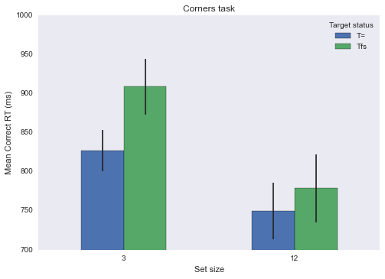
Seaborn
Add-on library for MatplotLib
Especially designed for displaying statistical data
Simply activate it by placing the line import seaborn as sns
at the top of your script

Slide 61
Seaborn | Context
Applies different dpi, font sizes, etc. for your figures depending on the destination context that you set
Context can be changed with
sns.set_context(<context>)
<context> can be:
paper
talk
poster
notebook

Slide 62




Seaborn | Styles
white
ticks; pallete=muted
darkgrid
ticks
Easily change the whole look of a figure with sns.set_style(<style>)

Slide 63

Seaborn | convenience functions
Seaborn also offers convenience methods for cumbersome Matplotlib operations
Let's return to the figure of Example 2:
ax = pt.mean().unstack().T.plot( kind="bar", rot=0, ylim=[.25,.75], grid=False)

Slide 64

Seaborn | convenience functions
Removing the top and right border + ticks, simply by calling sns.despine()
ax = pt.mean().unstack().T.plot( kind="bar", rot=0, ylim=[.25,.75], grid=False)
sns.despine()

Slide 65

Seaborn | convenience functions
Drawing the figure as a line plot, you can offset the spines with sns.offset_spines()
ax = (pt.mean().unstack().T*100).plot(
kind="line",
xlim=[-0.5, len(
pt.columns.levels[-1])-0.5],
ylim=[25,75],
style="o-",
yerr=error_bars,
grid=False,
xticks=range(len(
pt.columns.levels[-1]))
)
ax.set_ylabel("Accuracy (%)")
sns.despine(trim=True)
sns.offset_spines()

Slide 66

Seaborn | One more plot
Accuracy of facial emotion recognition per age
pt_age = raw_data.pivot_table(
values="ACC", index="Subject",
columns=["Age","FaceType"],
aggfunc="mean“
)*100
sns.set_style("darkgrid")
ax = pt_age.mean().unstack().plot(
kind='line'
)
ax.set_ylabel("Accuracy (%)")

Slide 67





Seaborn | Gallery

